Slide 1
EEE G626 Project Details
Vipin Kizheppatt

Slide 2
Project Details
Project can be done either as an individual or as a team
If doing as a team, maximum 3 members in a team
Individual performance will be evaluated during viva and individual grades will be assigned based on that

Slide 3
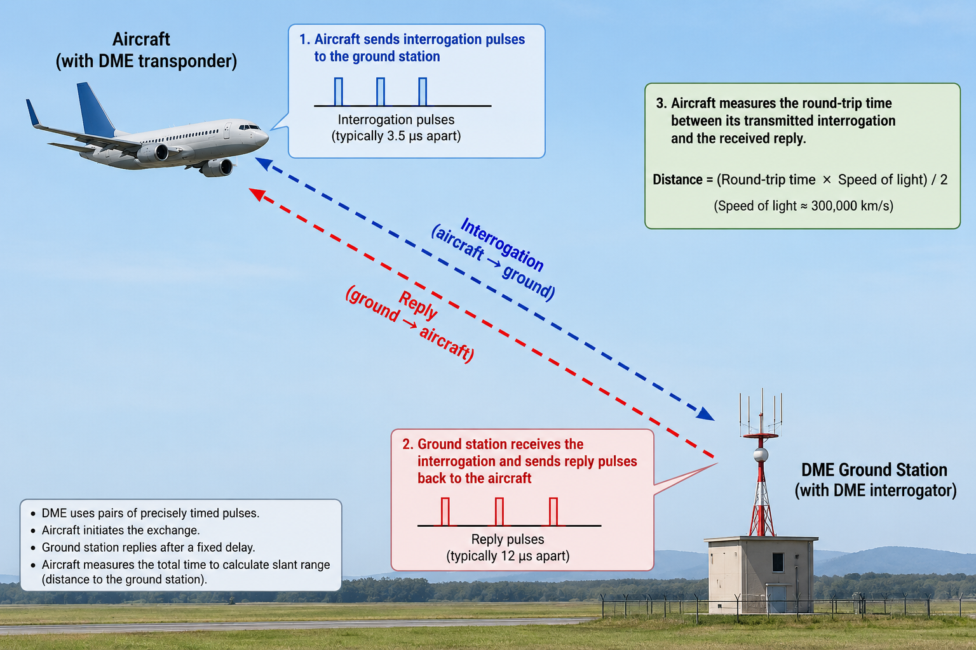
Project Objective
Design a distance measurement equipment (DME) for aircraft and its testing equipment

Slide 4
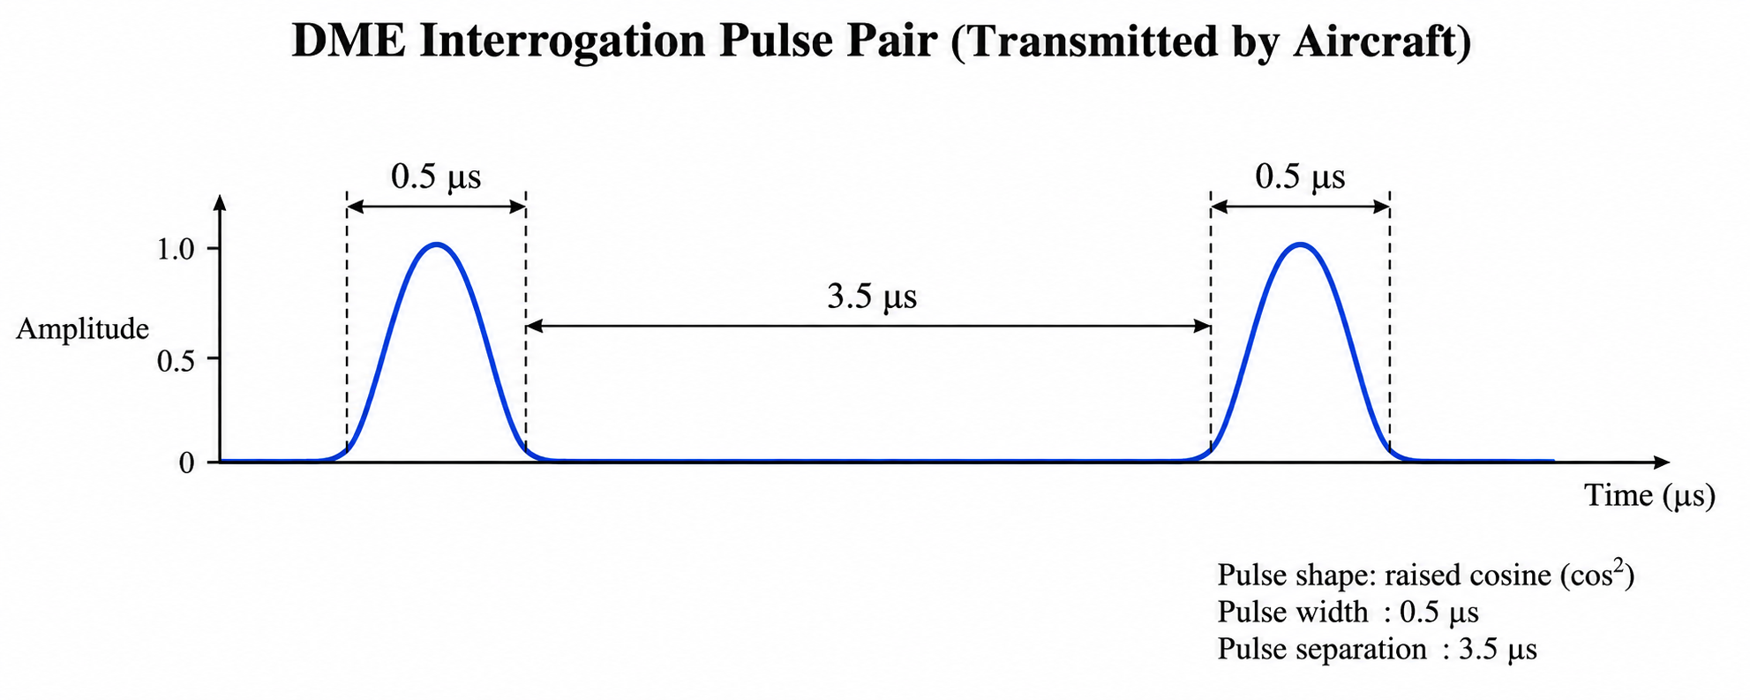
DME Pulse Generation
DME equipment generates pulses (rather pulse pairs) of precise timing specification
The timing specifies the width of the pulse, delay between pulses in a pair and delay between pulse pairs (pulse rate)
The pulse pair rate will be about 25-30 pulse pairs/second

Slide 5
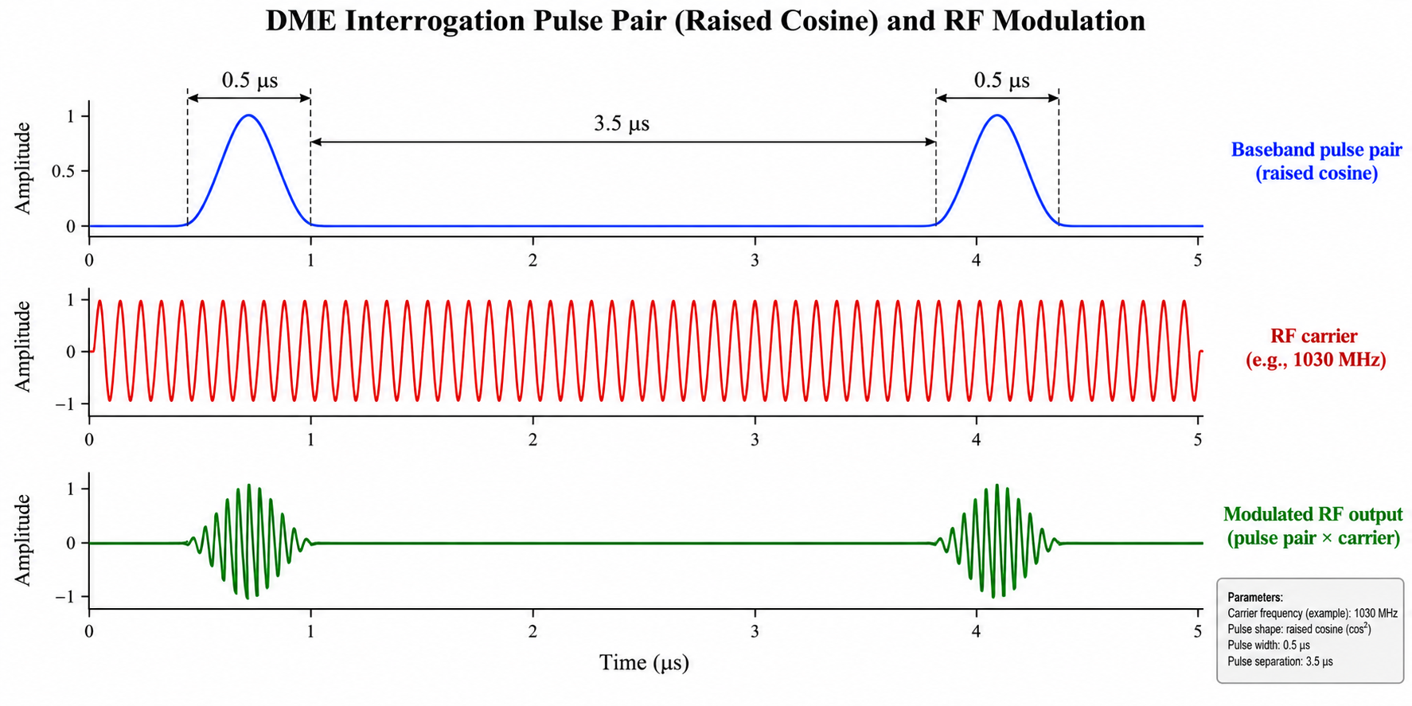
DME Pulse Generation
The pulses are then modulated using RF signal (960 – 1215 MHz)
The frequency of the RF signal depends on particular target airport
The modulated pulses are transmitted with an antenna

Slide 6
DME Pulse Generation
When the ground station receives the pulse pair, it adds a fixed delay (50us)
Modulates the pulse pair with a different frequency (the interrogation and reply frequency pairs are pre-defined) and sends back
The DME calculates the time between pulse pair transmission and reception, subtracts 50us from it and calculates the distance to ground station

Slide 7
Challenges
There are multiple aircrafts sending the pulse pairs simultaneously
This can corrupt the pulses
Aircraft need to identify whether a received pulse pair corresponds to its transmitted pair
Ground station may ignore pulse pairs when too many aircrafts interrogates (reply efficiency)
To keep constant reply rate, the ground station keeps sending arbitrary pulse pairs called squitters
Again aircraft need to ignore them

Slide 8
Project Deliverables
Design and implement pulse pair generator IP. Keep pulse width as 50u, inter pulse delay 350us
The pulse width and inter-pulse delay may remain constant, but pulse rate should be configurable from software
Modulate the pulse pairs using an internal carrier at 1 MHz (Check DDS IP)
Interface an DAC (through the PMOD connector) and convert the signals to analog and observe on the oscilloscope
Loop back DAC output through an ADC, and feed back to the FPGA
Demodulate the received pulses
Identify valid pulse pairs (through software or hardware)

Slide 9
Project Deliverables
Correlate transmitted pulse pairs with received pulse pairs (You may need software support to do this)
Calculate the distance to ground station
Design a DME test equipment with the following features
  Configurable reply efficiency from 40% to 100%
  When replying should add 50us delay to pulse pairs
  Configurable pulse rate with squitter enable disable option
  Model the distance to aircraft from 10NM to 200NM
  Model the aircraft flying towards or away from the ground station

Slide 10
System Architecture

Slide 11
Evaluation Metrics
Correctness of the output
Features supported
Flexibility

Slide 12
What to submit
IP package along with Vivado project for the complete project
Driver for the IPs and C main source code
A report explaining the architecture of your IP, algorithm used, performance (resource utilization, throughput, Fmax etc.)

Slide 13
Milestones
No | Milestone | Date
1 | Pulse pair generator with Driver and modulator | Sept 20-26 week
2 | Pulse demodulator and detector | Oct 12-16 week
3 | Ground station with at least delay and distance model | Oct 19-23 week
4 | ADC and DAC interfacing with loop back testing | Nov 2 – 6 Week
5 | Final Demo and evaluation | Nov 16 – 20 Week

Slide 14
Thank you any questions

